Slide 1




Module Name – Trees & BSTs
Topic Name: Binary Tree
Instructor: Arun Kudiyal
EditEdit MasterMaster texttext stylesstyles

Slide 2
Time Allocation Summary
Element | Slide numbers | Maximum time(min)
Today’s Agenda
Spot Test
Introduction to Trees
Introduction to Binary Tree – Properties of Binary Tree
Types of Binary Tree – Binary Tree Representation
Tree Traversals – DFS
Total Time |  | 120

Slide 3

Today’s Agenda
Introduction to Trees
Introduction to Binary Tree – Binary Tree Properties
Types of Binary Trees – Binary Tree Representation
Tree Traversals – Depth First Search (DFS)

Slide 4
Introduction to Trees
Unlike Arrays, Linked Lists, Stack and queues, which are linear data structures, trees are hierarchical Data Structures.
Generally in Data Structures, a normal tree is nothing but a Binary Tree.
Binary Tree is a special Data Structure used for data storage purposes.

Slide 5
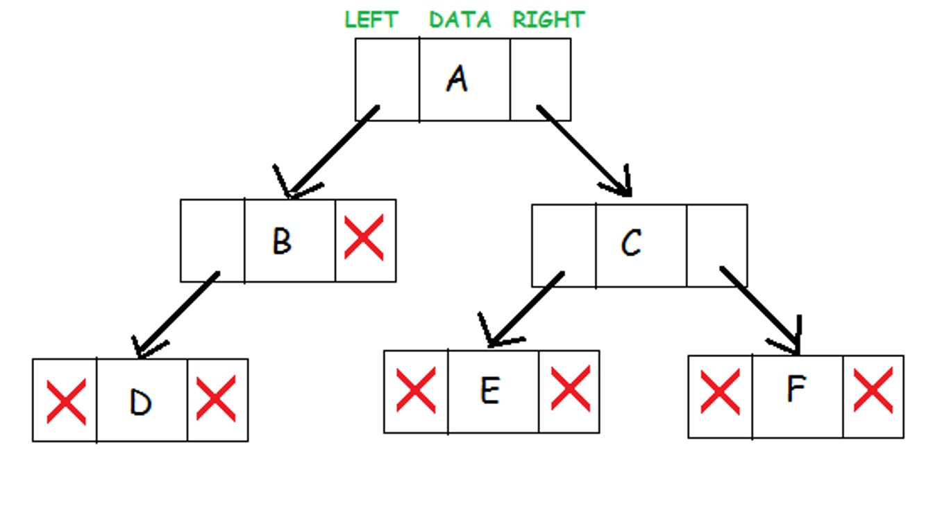
Typical Representation of a Tree

Slide 6
Introduction to Binary Tree
Binary Tree is a special Data Structure used for data storage purposes.
Binary Tree's name represent it's functionality
Binary Tree is a very special Data Structure used for data storage purposes which contains it's left and right child namely.
Binary Tree has a special condition that each node can only strictly contain only two children.

Slide 7
Tree Terminologies
Path - Path refers to the sequence of nodes along the edges of a tree..
Root – The node at the top of the tree is called root. There only exist one root per tree.
Parent – Any node except the root node has one edge upward to a node called parent.
Child – Any node below a given node connected by its edge downward is called its child node.
Leaf – The node which does not have any children is called a leaf node.
Subtree – The descents of any given node is called a Subtree.

Slide 8
Tree Terminologies
Visiting - Visiting refers to checking the value of a node when control is on the node.
Traversing – Traversing means passing through nodes in a specific order.
Level – Level of a node represents the generation of a node. If the root node is at level 0, then its next child node is at level 1, its grandchild is at level 2, and so on.
Key – Key represents a value of a node based on which a search operation is to be carried out for a node.

Slide 9
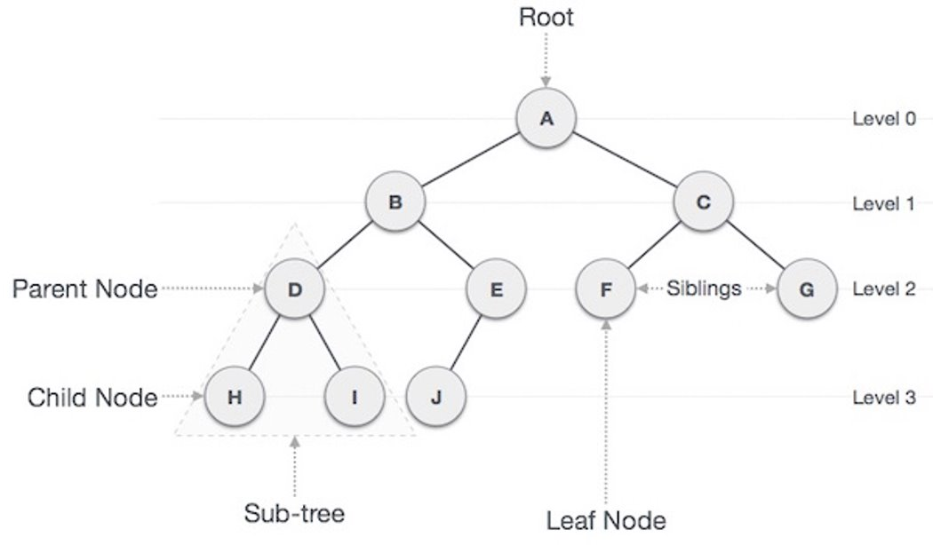
Tree Terminologies

Slide 10
Properties of Binary Tree
N The maximum number of nodes at level ‘i’ will be 2 ^ (i−1), considering root node starting with level 1
Maximum number of nodes present in binary tree of height h is (2^h)−1 . Here height is the max number of nodes on root to leaf path, considering height of a tree with one node is 1.
If a Binary Tree has 0 or 2 children, then the number of leaf nodes are always one more than the nodes with 2 children

Slide 11
Types of Binary Tree
Full Binary Tree – A Binary tree is a 'Full Binary Tree', if the tree has 0 or 2 children exactly. We can also say a full binary tree is a binary tree in which all nodes except leaves have two children.
Complete Binary Tree - A Binary Tree is a 'Complete Binary Tree' if all levels are completely filled except possibly the last level and the last level has all keys as left as possible.
Degenerated Tree - A degenerate (or pathological) tree is a tree where every internal node has one child. Such trees are performance-wise same as linked list.
Perfect Binary Tree – A Prefect (strictly) Binary Tree is a tree in which all the internal nodes have 2 children and all leaves are at the same level.

Slide 12
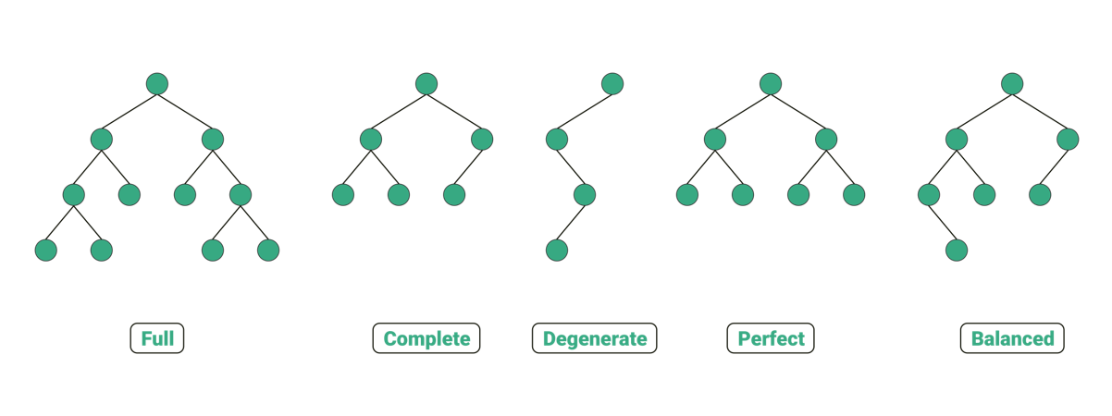
Types of Binary Tree

Slide 13
Real Life Application of Trees
File System Architecture (FSA) – FSA of many Operating Systems like Unix, Linux and MacOS uses tree like FSA.
Web Based Technologies - Technologies like HTML, CSS, JavaScript, DOM, Angular and React uses tree like implementation in coding.
Social Networking Sites - Networking sites like LinkedIn, Facebook, , Instagram, Twitter etc. uses Tree implementations.
Advanced Technologies – High Graded technology like Micro Processing, Data Science and Artificial Intelligence makes a great use of Trees for problem solving.

Slide 14
Java Implementation of a Binary Tree
A tree whose elements have at most 2 children is called a binary tree. Since each element in a binary tree can have only 2 children, we typically name them the left and right child.
public class Node {
int key; // data to be stored in the Node
Node left, right; // left and right children of the Node
// default constructor
public Node(int item) {
key = item; // store the value to the data
left = right = null; // initially make children null
}
}

Slide 15
Java Implementation of Merge Sort
class BinaryTree {
Node root;
BinaryTree(){
root = null;
}
BinaryTree(int key) {
root = new Node(key);
}
public static void main (String[] args) {
// creates the tree with root as null
BinaryTree tree = new BinaryTree();
// create the root node
tree.root = new Node(100);
// sub-tree of root node
tree.root = new Node(100);
tree.root = new Node(100);
tree.root = new Node(100);
tree.root = new Node(100);
}

Slide 16
Tree Traversals
Depth First Search – DFS is a technique used for traversing tree or graph.
Here backtracking is used for traversal
In this traversal, first the deepest node is visited and then backtracks to its parent node if no sibling of that node exist.
Depth First Serach (DFS) as discussed travers to the deepest node and tracks back to the parent node. DFS are typically of three types:
in-Order DFS Traversal
pre-Order DFS Traversal
post-Order DFS Traversal

Slide 17
in-Order DFS Traversal
The in-Order traversal follows a simple approach of dividing the tree and traversing it one by one. Let us have a look at the algorithm:
Traverse the Left sub-tree.
Visit the root.
Traverse the Right sub-tree
public void inOrder(Node root) {
// check the base condition
if(root == null)
return;
// traverse the left sub-tree
inOrder(root.left);
// print the node
System.out.print(root.key + " ");
// traverse the right sub-tree
inOrder(root.right);
}

Slide 18
pre-Order DFS Traversal
The in-Order traversal follows a simple approach of dividing the tree and traversing it one by one. Let us have a look at the algorithm:
Visit the Node
Traverse the Left sub-tree
Traverse the Right sub-tree
public void preOrder(Node root) {
// check the base condition
if(root == null)
return;
// print the node
System.out.print(root.key + " ");
// traverse the left sub-tree
preOrder(root.left);
// traverse the right sub-tree
preOrder(root.right);
}

Slide 19
in-Order DFS Traversal
The in-Order traversal follows a simple approach of dividing the tree and traversing it one by one. Let us have a look at the algorithm:
Traverse the Left sub-tree.
Traverse the Right sub-tree
Visit the Node.
public void postOrder(Node root) {
// check the base condition
if(root == null)
return;
// traverse the left sub-tree
postOrder(root.left)
// traverse the right sub-tree
postOrder(root.right);
// print the node
System.out.print(root.key + " ");
}

Slide 20

Thank You!
Happy learning!
#LifeKoKaroLift

